Slide 1

Non-Brand CPA Trend
£46 → £64
Account Structure & Issues
+40% increase year-on-year while spend nearly doubled
1,511
47
6.4
Dental by Design | Prodent Group
Ghost Conversions (KMG)
Total Campaigns
Avg QS (Weighted)
Christopher Hoole
Google Ads Specialist | April 2026
christopherhoole.com
Data: 2025 (full year) + 2026 (Q1, Jan–Apr)

Slide 2
Executive Summary
2025 + 2026
£46→£64
1,511
90%
6.4/10
Non-Brand CPA (+40%)
Ghost Conversions (KMG Legacy)
Ads Rated Poor or Average
Weighted Avg Quality Score
Key Issues Identified
1,511 ghost conversions from legacy KMG landing pages inflating reported performance. Giulio confirmed these should be ignored — but they’re still Primary.
PMax: 81.7% of spend is Google Search. Display burns £1,893/month on mobile games for 2 conversions. Top converting terms are NHS/free seekers. Real booking CPA is £418.
Non-brand CPA risen 40% YoY (£46→£64). Monthly spend nearly doubled from ~£22K to ~£58K.
90% of ads rated Poor/Average. The main Search campaign (£74,024 spend) has Poor-rated ads. Ad relevance Below Average on 71% of keywords.
ROAS bidding based on arbitrary £300 values + PMax only has 93 negative keywords vs 2,192 across the account — essentially unprotected.
The core issue: the account is scaling spend aggressively but the foundations (conversion tracking, ad quality, keyword Quality Scores) haven't kept pace. Higher spend on weak foundations = rising CPA.
Christopher Hoole | christopherhoole.com | Confidential
2

Slide 3
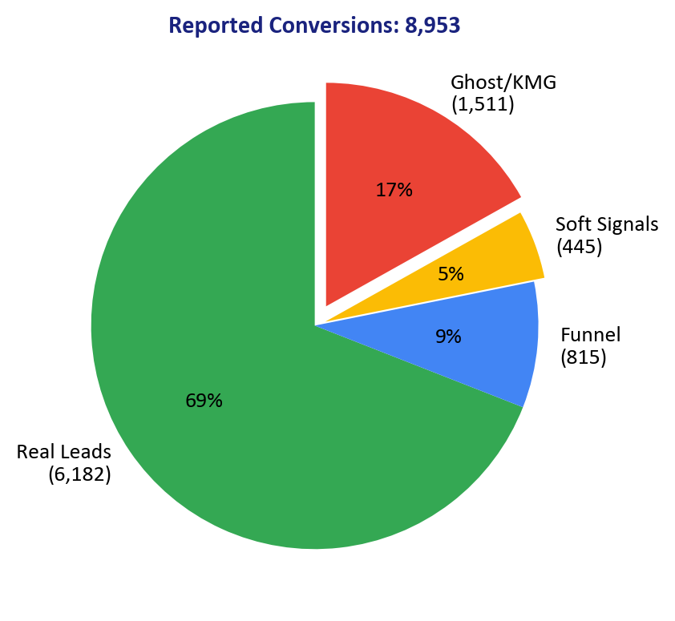
Conversion Tracking Audit
Critical Issue
1,511 ghost conversions + 445 soft signals are inflating reported performance
Conversion Classification
Category | Conversions | % of Total | Status
Real Leads (forms, calls, quiz) | 6,182 | 69% | Legitimate
Funnel (Dengro bookings + purchases) | 815 | 9% | Legitimate (downstream)
Soft Signals (clicks, not actions) | 445 | 5% | Should be Secondary
Ghost (KMG legacy — confirmed ignore) | 1,511 | 17% | Should be removed
Impact on CPA
Giulio Confirmed
Reported CPA: £49 (using all 8,953 conversions) Real leads CPA: £71 (excluding ghost + soft signals) Leads + funnel CPA: £63 (including bookings) The bidding algorithm is optimising toward 8,953 events — including 1,511 that don't exist and 445 that aren't real actions. This is why CPA appears lower than it actually is.
KMG OLD LP actions: "data that have been preserved but target old lp" — confirmed ghost data. Dengro Offline Lead: Lead from CRM. Dengro Offline Booking/Purchase: Booked/completed patient. Every booking has an arbitrary £300 value.
Christopher Hoole | christopherhoole.com | Confidential
3

Slide 4
The ROAS Puzzle
Bid Strategy
Target ROAS bidding is based on arbitrary £300 booking values — not real revenue
Current Bid Strategy Setup
The Dengro Pipeline
Campaign | Bid Strategy | Target ROAS | 2026 CPA
Dental Implants — PMax | Max Conv Value (tROAS) | 30% | £52
Dental Implants Intent | Max Conv Value (tROAS) | 60% | £94
Brand | Max Conv Value (tROAS) | 10% | £18
Dengro Offline Lead: 4,663 (all CRM leads — may include non-ad sources) Dengro Offline Booking: 621 (£300 arbitrary value each = £70,910) Dengro Offline Purchase: 194 (completed treatment = £73,106) Lead → Booking conversion rate: 13.3% (621/4,663) Booking → Purchase conversion rate: 31.2% (194/621)
Why This Is a Problem
Recommendation
The algorithm is told to maximise conversion VALUE, not conversion VOLUME. With £300 arbitrary booking values, a 30% ROAS target means the algorithm wants £300 in value for every £1,000 spent — i.e. one booking per £1,000 spend. But only 621 of 8,953 reported conversions are actual bookings. The algorithm is chasing a small pool of high-value events while spending broadly. This explains why PMax CPA rose from £26 to £52 — it's optimising for bookings, not leads, but the booking signal is sparse and unreliable with an arbitrary value.
Option A: Switch to Maximise Conversions with Target CPA. Optimise for LEAD VOLUME at a controllable cost per lead. This gives direct control over acquisition cost. Option B: Keep Target ROAS but replace the £300 arbitrary value with actual treatment revenue from Dengro. If a booking for a single implant is worth £1,695 and a Vivo Bridge is worth £15,990, the algorithm can intelligently bid more for high-value treatments. Either option is better than the current setup.
Christopher Hoole | christopherhoole.com | Confidential
4

Slide 5
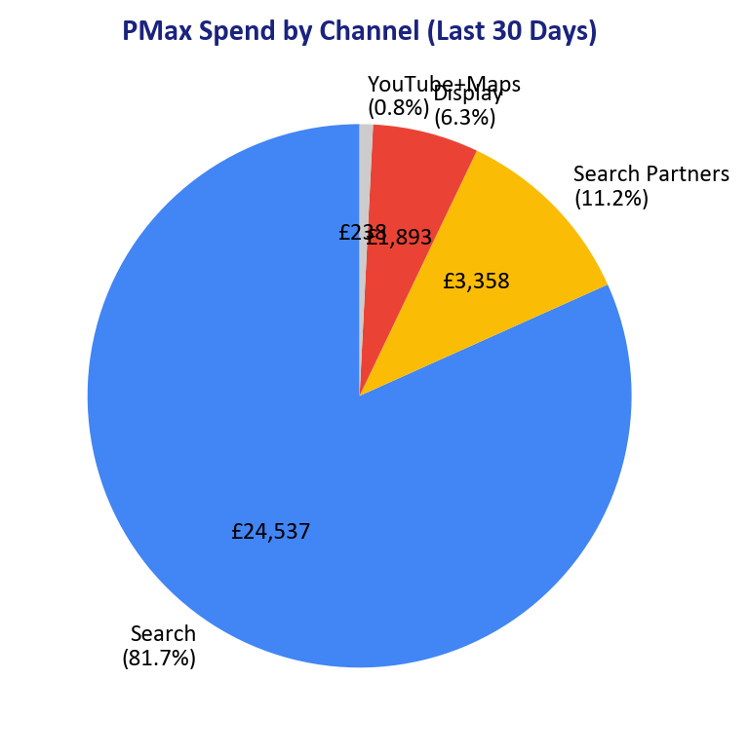
PMax — Deep Dive
Last 30 Days
81.7% of PMax spend is Google Search. Display waste on mobile games. Top leads are NHS/free seekers.
Channel | Spend | % of Total | Conv | CPA
Google Search | £24,537 | 81.7% | 311 | £79
Search Partners | £3,358 | 11.2% | 141 | £24
Display Network | £1,893 | 6.3% | 2 | £947
YouTube | £169 | 0.6% | 6 | £28
Maps | £69 | 0.2% | 1 | £69
Display: £1,893/month for 2 Conversions
4,700 mobile app placements including Block Blast, Colour by Number, Happy Color, Jigsawscapes, Snake Clash. These are not dental implant patients. This is pure waste.
Top PMax Converting Terms (Last 30 Days)
Real Booking CPA: £418
Search Term | Conv | CPA
how to apply for dental implants on the nh | 31 | £12
free dental implants near me | 30 | £24
how to get free dental implants on nhs | 14 | £22
nhs dental implants over 60 | 5 | £11
Only 72 actual bookings from £30,026 spend. The “low CPA” is an illusion — PMax finds cheap conversions from NHS/free seekers who never become patients. Only 93 negative keywords protect PMax vs 2,192 across the account.
Christopher Hoole | christopherhoole.com | Confidential
5

Slide 6
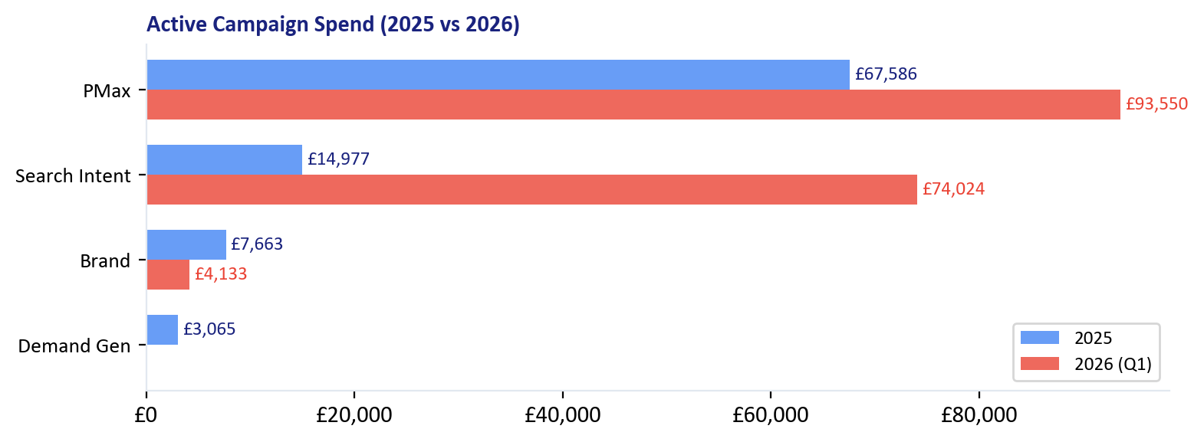
Account Structure
Structure
47 campaigns, 4 active — a legacy of multiple agencies and strategy changes
Currently Active (4 Campaigns)
Campaign | 2025 CPA | 2026 CPA | Change
PMax | £26 | £52 | +100%
Search Intent | £61 | £94 | +54%
Brand | £17 | £18 | Stable
Demand Gen | £180 | — | Not serving
The 43 Paused Campaigns
Legacy Agencies
Historical Experiments
Recommendation
KMG (Kau Media Group): 6 campaigns, L87K spend Multiple naming conventions and strategies KMG conversion actions still firing as Primary
Device-split campaigns ('Mobile Only', 'Desktop') Geo-split campaigns ('London', 'Geo') Service campaigns (Invisalign, Veneers, Full Arch, Teeth In A Day) Dating back to 2022
Remove all campaigns paused 6+ months with no active learnings. This doesn't affect performance but makes the account manageable. Clean structure is essential for multi-clinic expansion.
Christopher Hoole | christopherhoole.com | Confidential
6

Slide 7
Ad Group Structure (2026)
2025 vs 2026
Search Intent campaign: 8 ad groups with wide CPA variation
Campaign | Ad Group | Spend | Conv | CPA | CVR
Dental Implants Intent | Dental Implants | £26,644 | 240 | £111 | 8.9%
Dental Implants Intent | Implants Cost | £17,280 | 217 | £80 | 7.3%
Dental Implants Intent | All on 4 Google | £10,210 | 96 | £106 | 6.6%
Dental Implants Intent | All on 4 | £6,283 | 49 | £128 | 5.5%
Dental Implants Intent | Implants Cost Google | £4,588 | 46 | £100 | 6.2%
Dental Implants Intent | Dental Implants Google | £4,499 | 41 | £111 | 6.4%
Brand | Dental by Design | £4,133 | 230 | £18 | 13.6%
Invisalign - Geo | Invisalign London | £3,679 | 81 | £45 | 10.1%
Dental Implants Intent | Financing | £2,890 | 86 | £34 | 24.7%
Dental Implants Intent | Dental Implants Hammersmith | £1,631 | 12 | £142 | 3.6%
Invisalign - Geo | Invisalign Hammersmith | £81 | 2 | £54 | 10.7%
Key Finding
Recommendation
The 'Dental Implants' ad group (£26.6K) runs at £111 CPA — the worst in the account. Meanwhile 'Financing' (£2.9K) runs at £34 CPA with 24.7% CVR. Budget is flowing to the least efficient ad groups.
The 'Financing' and 'Implants Cost' ad groups convert better because they match cost-conscious search intent with the right landing page. Restructure ad groups around patient intent, not just keyword categories.
Christopher Hoole | christopherhoole.com | Confidential
7

Slide 8
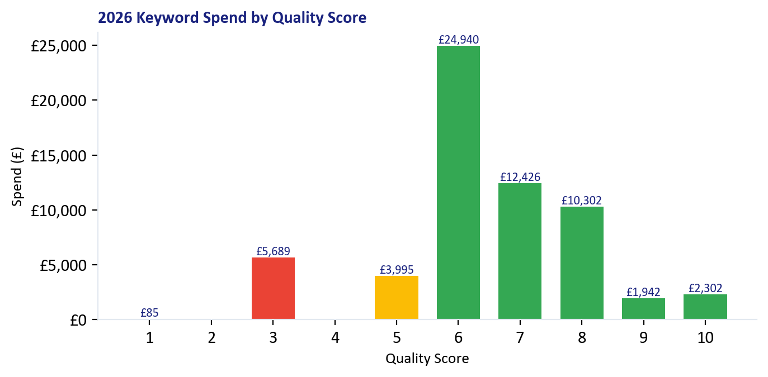
Quality Score Analysis
2025 vs 2026
Weighted average QS: 6.9 (2025) → 6.4 (2026) — declining
QS Components (2025 vs 2026)
Component | 2025 Below | 2025 Above | 2026 Below | 2026 Above
Ad Relevance | 57 (74%) | 12 (16%) | 58 (71%) | 14 (17%)
Expected CTR | 51 (66%) | 7 (9%) | 52 (63%) | 8 (10%)
Landing Page | 3 (4%) | 55 (71%) | 3 (4%) | 58 (71%)
Worst QS Keywords (QS 1-3) — 2026 Spend
Consistent Pattern Both Years
Keyword | QS | Spend | CPA | Ad Rel.
[surgical dental implants] | 3 | £3,909 | £112 | Below average
[cost to replace all teeth] | 3 | £559 | £74 | Below average
[dentist with payment plans near me | 3 | £311 | £27 | Below average
[permanent bridge teeth] | 3 | £244 | £214 | Below average
[molar replacement cost] | 3 | £159 | £40 | Below average
Landing pages: strong (71% Above Average both years). Ad relevance: weak (74% Below 2025, 71% Below 2026). The ads don't match what people search for.
Note: In 2025, most low-QS keywords (1-5) had zero spend because the Search Intent campaign was only active late in the year. The QS issues have emerged as this campaign scaled in 2026.
Christopher Hoole | christopherhoole.com | Confidential
8

Slide 9
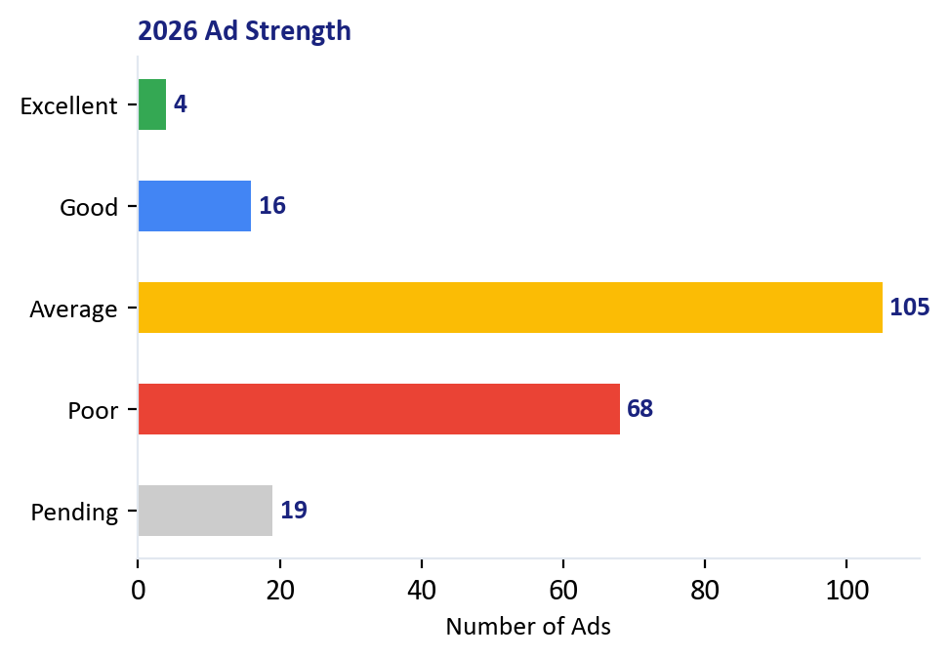
Ad Copy Audit
Current State
90% of ads rated Poor or Average — the primary driver of low Quality Scores
Current Ad Strength (All Ads in Account)
Strength | Count | % of Total | Impact
Excellent | 4 | 2% | Keep — best performers
Good | 16 | 8% | Keep — performing well
Average | 105 | 50% | Rewrite — opportunity to improve
Poor | 68 | 32% | Rewrite urgently — dragging QS down
Pending | 19 | 9% | New ads — monitor
Critical Finding
The main Search Intent campaign (£15K spend in 2025, £74K in 2026) has Poor-rated ads. This directly causes Below Average ad relevance on 71% of keywords. Poor ads = low QS = higher CPCs = higher CPA. This has been the case across both years.
Spend on Poor/Average Ads
Recommendation: Rewrite all Poor and Average ads. Match headlines to search intent. Test 2-3 RSA variants per ad group.
2025: £265,869 total spend — same ads running throughout 2026: £175,467 total spend — same ads, but at nearly double the budget The ads haven't been rewritten as spend has scaled. The same Poor-rated ads that ran at £15K/month are now running at £58K/month.
This is the #1 lever for reducing CPA. Better ads = higher QS = lower CPCs = more patients for the same budget.
Christopher Hoole | christopherhoole.com | Confidential
9

Slide 10
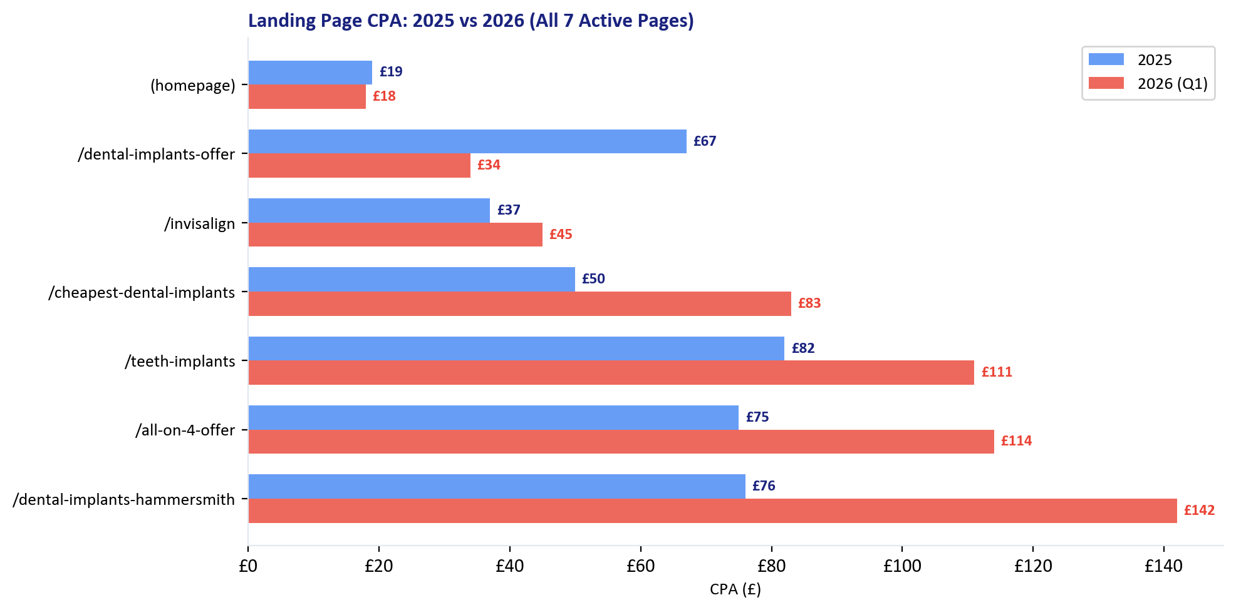
Landing Page Performance
2025 vs 2026
CPA varies 7x+ across landing pages — and has worsened year-on-year on the top pages
Best Performer
/dental-implants-offer: 2025: £67 CPA, 6.8% CVR 2026: £34 CPA, 24.7% CVR Improved as Financing ad group sends cost-conscious traffic here.
Worst Performer
/teeth-implants (highest spend): 2025: £82 CPA, 9.3% CVR 2026: £111 CPA, 8.5% CVR CPA risen 35% YoY despite receiving £31K in 2026 — the most of any page.
The Good News
Recommendation: Route traffic to the best-converting pages. /dental-implants-offer at £34 CPA should receive more traffic than /teeth-implants at £111.
QS data confirms landing pages score well (71% Above Average both years). The pages aren't the problem — it's which traffic reaches which page.
Christopher Hoole | christopherhoole.com | Confidential
10

Slide 11
Change History
Account Management
2,543 changes — 89% by one person, 24 by auto-apply
Who Manages the Account
What's Being Changed
User | Changes | Role
giulio.zanchetta@majestico.it | 2,264 (89%) | In-house (Giulio)
taranjeet@kaumediagroup.com | 166 (7%) | Previous agency (KMG)
nav@kaumediagroup.com | 40 | Previous agency (KMG)
Recommendations Auto-Apply | 24 | Google system
junad@kaumediagroup.com | 22 | Previous agency (KMG)
sarahm@kaumediagroup.com | 14 | Previous agency (KMG)
Google Ads System | 4 | Google system
Category | Count | Assessment
Keywords added/paused | 1,315 | Highest activity — frequent keyword management
Campaign changes | 715 | Many campaigns created and paused over time
Targeting | 420 | Location, device, audience changes
Ad changes | 418 | Ad creation and modification
Bid strategy | 223 | Multiple strategy changes over time
Budget changes | 198 | Frequent budget adjustments
Assets (PMax) | 197 | PMax asset group management
Negative keywords | 182 | Negative keyword additions
Key Observation
Auto-Apply: 24 Changes
Giulio is doing the work of a full-time PPC specialist alongside his other responsibilities. 2,264 changes shows significant effort and engagement with the account. The issue isn't lack of activity — it's that the foundations (conversion tracking, ad quality, negative keywords) need specialist attention that goes beyond day-to-day management.
Google auto-removed keywords including [low cost dental implants], [cheapest dental implants], [all on 6 dental implants], [implant teeth cost], and [replace teeth]. Several of these are high-intent keywords that should be in the account. Auto-apply is removing keywords without human oversight — recommend disabling.
Christopher Hoole | christopherhoole.com | Confidential
11

Slide 12
Issues Summary — Prioritised
14 Issues Identified
Critical (Fix Immediately)
Important (Fix in 30 Days)
Monitor (Ongoing)
1. Ghost conversions (KMG)
1,511 phantom conversions misleading algorithm. Confirmed by Giulio.
2. PMax lead quality
Top converting terms are NHS/free seekers. Real booking CPA £418. Only 93 negatives protecting PMax.
3. PMax Display waste
£1,893/month on mobile games for 2 conversions. 81.7% of PMax spend is Search anyway.
4. ROAS on arbitrary £300 values
Algorithm chasing sparse bookings, not optimising for lead volume.
5. 90% of ads Poor/Average
Below Average ad relevance on 71% of keywords. Never rewritten.
5. No device bid adjustments
Desktop £67→£92 vs mobile £42→£56. Gap widening.
6. No ad schedule adjustments
7am: £56→£74 CPA (worst both years). No scheduling exists.
7. No day-of-week adjustments
Sunday: £45→£68 CPA, 4.1% CVR (lowest). Emerging problem.
8. 47 campaigns (43 paused)
Structural confusion from legacy agencies. Remove all paused 6+ months.
9. Auto-apply enabled
24 keyword removals without human review. Disable immediately.
10. 784 broad match negatives
Account-level lists may block legitimate traffic. Full audit needed. Replace with phrase/exact.
11. Landing page CPA variance
7x+ range (£18–£142 in 2026). Optimise traffic routing to best-converting pages.
12. Quality Score declining
Weighted avg: 6.9→6.4. Ad relevance is the driver. Ad rewrites will address this.
The 5 Critical issues affect every conversion and every pound spent. PMax lead quality and Display waste are new findings that change the restructure plan fundamentally.
Christopher Hoole | christopherhoole.com | Confidential
12

Slide 13
Coming Next
Report 3: Restructure Plan
What's Next
Proposed campaign structure, bid strategy, conversion tracking fixes, ad copy plan, and projected CPA targets.
These issues become the foundation for Report 3
1. Remove KMG ghost conversions + soft signals
5
5
Report 3
2. Block NHS/free seekers from PMax
Critical Issues
Important Issues
Coming Next
3. Add Display exclusions to PMax
4. Rewrite all Poor/Average ads
5. Evaluate PMax → Search migration
6. Evaluate bid strategy: tCPA vs tROAS

